Slide 1

User Experience
Case Study
By Tyler Kiser
7/27/21

Slide 2
Agenda
Overview of Experiment
Client Demographics and Interaction
Defining Success
Measurement
Experiment Summary
Experiment Improvement Recommendations
Notes:
30 seconds

Slide 3
Overview of Experiment
Customer Journey Hypothesis:
A more modern UI and in-context prompts would make clients feel more comfortable with our digital process and lead to higher completion rates.
Experiment Overview
A control group was exposed to the current state experience while the test group saw a newly redesigned experience with improved UI, navigation, and in-line help.
Both the test and control experiences have the same number of process steps. 5 steps in total
Experiment Timeframe
3/15/2017 – 4/30/2017
Total duration 47 days (1.5 months)
Test and Control Groups (72% of all Vanguard Clients)
Test: 26,968 clients (53.4%)
Control: 23,532 clients (46.6%)
20,109 clients that interact with this process were not part of either the test or control group. This represents 28% of all Vanguard clients.
Start Page
Step 1
Step 2
Confirmation Page
Step 3
Notes:
1:30

Slide 4
Client Demographics

Slide 5
Client Demographics – Control VS Test – Distribution of Clients

Slide 6
How and when do clients interact with this process?

Slide 7
How and when do clients interact with this process?
Wednesday
Wednesday
Wednesday
Wednesday
Notes:
1:20
When we look at unique visits by date, a peculiar trend arises. There are spikes in visits on certain days. All of these days are on the same day of the week, Wednesdays. Also, there appears to be hardly any visits between march 15th and March 29th …… I was not able to determine the reason for this without context, but this is definitely something I would explore further to ensure there was not an issue with the test.
In this chart we can see that 30% of all visits occur on Wednesday. So perhaps there is something Vanguard sends to Clients every Wednesday that is increasing the number of visits.
This next chart shows distribution of visits by time of day. There is a large spike in visits in the afternoon which then gradually declines into the evening.
20% of visits occur before 11AM
30% 11AM – 1PM
50% after 1PM
Lastly, 90% of clients interact with the process on just 1 device.

Slide 8
Defining “Success”

Slide 9
Defining “Success”
Completion
Improve distribution of clients that complete all steps
Improve distribution of clients that complete confirmation
Decrease distribution of clients that skip steps
Simplification
Decrease time to complete all steps
Minimize number of client visits
Decrease number of total steps within a visit
Decrease number of clients that duplicate steps
Assistance
Decrease number of clients that need on-call assistance from Vanguard
Notes:
3 minutes
Next Lets Define Success for this Experiment
Success can be divided into 3 categories
Completion, Simplification and Assistance
Success from a completion standpoint can be defined as the following…. Improving the distribution of clients that completed all of the steps, improving the distribution of clients that reached confirmation, and decreasing the distribution of clients that skip steps.
Why break out completion into these 3 categories?
If the process was created to cater to the needs of clients, then we can assume each step has its own purpose and is important to both the client and Vanguard. This is why is it important to look at completion of the process as a whole as well as completion of the confirm step. For the analysis throughout this presentation, I have chosen to define success as completing all of the steps.
This being said, completing all of the steps and completing the confirmation step are highly correlated, so from an analysis perspective the results looks the same, regardless of which metric is used.
The second category of success, Simplification, can be defined as the following…
Decrease time to complete all steps
Minimize number of client visits
What is a visit? A visit is simply a user session on the website. Visit is defined as a sequence of consecutive page views without a 30-minute break, or continuous activity for 30 minutes). Now there are some data integrity issues related to this definition, which I will touch on later. But ultimately, the goal should be to have clients complete the process within 1 visit, rather than multiple visits.
Decrease number of total steps within a visit
Theoretically the goal would be to have all clients have 5 total steps, as that is the minimum number of steps needed to complete the entire process.
Lastly,
Decrease Number of duplicated steps
These measures of success allow us to determine if the new user experience was easier or harder than the existing experience. Ultimately we want the experience to be easier, faster, and simpler, as that will lead to a more enjoyable client experience.
Lastly, the final measure of success is assistance. Assistance can be defined as whether or not we decrease the number of clients that needed on call assistance from vanguard.
Completing all steps or reaching the confirm step?
Completing all steps
Why?
We can assume that each step is created for an important reason. If clients are skipping steps, but reaching confirmation, they may have missed an important piece of the customer journey.
Time it takes to complete all steps or reach confirmation?

Slide 10
Measuring Completion

Slide 11
Measuring Completion
Goals
Improve distribution of clients that complete all steps
Improve distribution of clients that complete confirmation
Decrease distribution of clients that skip steps
Notes:
1:50
First, here are our competition measurement goals as a reminder.
This chart shows the distribution of clients that completed each step for both the test and control group. Through out this presentation the test group will always be shown in the color orange, while the control will be shown as blue. The test compared to the control will be shown as black.
Pretty much everyone completes the start and then there is about a 10% decrease in the number of clients that complete each subsequent step, by the end of the process a little over 60% reach confirmation.
When we compare the test group to the control group, the results are positive.
The test group has a higher percentage of clients that complete each step and also a higher percentage of clients that complete all of the steps.
Completion of confirmation rose 8% while completion of all of the steps rose 7%. The reason these numbers are different is due to clients skipping steps. Step skipping represents a very small number of confirmed clients, 1% of the control group and 2% of the test group.
So from a success perspective, the experiment was successful for improving the distribution of clients that completed all steps, as well as the distribution of clients that reached confirmation, but it was not successful for decreasing the distribution of clients that skipped steps.

Slide 12
Measuring Simplification

Slide 13
Measuring Simplification
Goals
Decrease time to complete all steps
Decrease number of client visits
Decrease number of total steps within a visit
Decrease number of duplicated steps
+717%
+22%
+6%
+8%
+32%
+20%
+34%
-10%
-30%
Notes:
3:00
These KPIS will give us a better understanding of how clients interact with the process, while also allowing us to see if there are any differences between the test and control group.
You will notice that I broke apart the charts into 3 categories. Uncompleted process, completed process, and total. This will allow us to examine the data to better understand what clients that aren’t completing the process are doing differently.
First, the average client interacts with this process 1.4 times per 47 day. So this process is used roughly once a month by clients. This is consistent with both the control and test. Clients that don’t complete the process have a slightly higher average number of visits. For both the test and control 70% of client visited 1 time within the test period, while 30% visited 2 or more times.
Now lets look at the average number of total steps per client, including duplicate steps. Average number of total steps grew by 8% in the test group. Most of this is driven by clients that did not complete the process. Average number of total steps for this segment rose 22%, while Average number of total steps for clients that completed the process rose 6%.
What steps are more duplicated?
Here we can see that duplicated steps decrease the further a client goes in the process.
There are several notable concerns with the test group. Duplicates rose significantly in the start and in step 1, while they decreased in step 2 and step 3. Also, the confirm step saw a massive increase in duplicates in the test group.
Both of these would be good to investigate further to identify a cause.
Overall duplicates rose 20% for clients that completed all of the steps.
In summary, while completion KPIs show positive results. Simplification KPIs show negative results. This means there is opportunity to drive completion results even higher if the issues that are driving poor simplification results are resolved.
I have addressed client visits, total steps within a visit, and duplicated steps. Now lets return to talk about time measurement and the unique challenges that come with it.

Slide 14
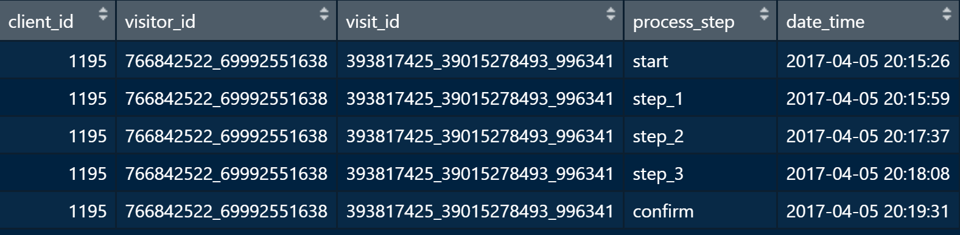
Client Journey Examples
Perfect Process
Notes:
0:30
Before I address the measurement of time. Let me walk you through some examples of the client journey, to highlight the unique challenges that come with measuring the amount of time a client spends within the process.
This first example is the perfect process, all 5 steps, completed in order, with no duplicates and completed within the same day.
It would be great if all client journey’s were this simple, but unfortunately they are not.

Slide 15
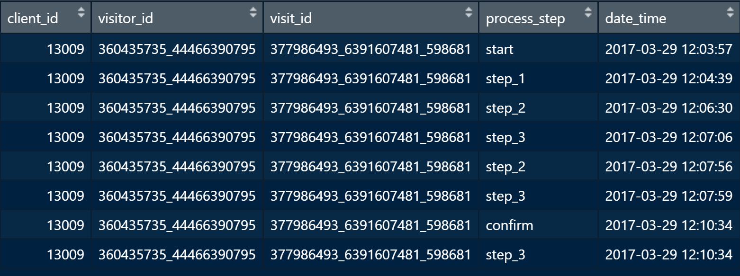
Single Step
Duplicate Steps
Notes:
0:30
Here are two issues that arise.
The first is the single step client. Single steps only have one time stamp, this means that we do not have a time frame to measure. Single events show a time of 0 because there is not an end time period to compare to.
The second issue is duplicate steps. You can see that this client duplicates steps 2 and 3. There are steps out of order, and steps with duplicate times, which likely indicates some sort of data integrity issue.

Slide 16
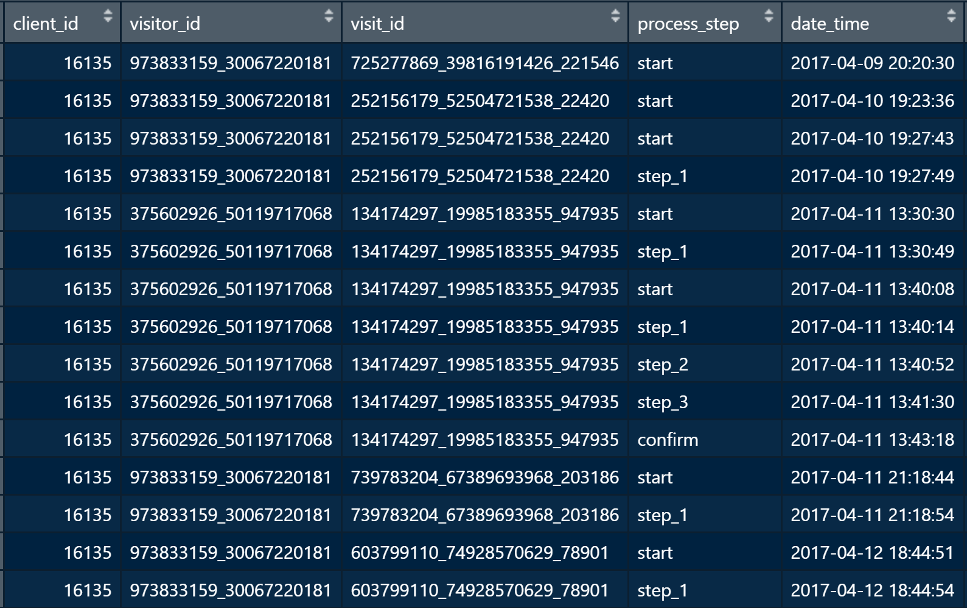
Multi-day Duplicate StepsD
Notes:
0:10
This last example is a complex example. This client has duplicate steps completed on multiple different days and out of order.

Slide 17
Average Client Visit Time
+30%
-1%
Notes:
12:20
+3:00
Given all of these things. Measuring time must be done with caution. There is risk that the measurement is inaccurate.
To minimize this risk we can reduce the size of our test and control groups to remove clients that experience most of these issues. To do so we can reduce to clients that only have 1 visit and at least 2 events per visit. This removes impact from multiple days, and single events
This reduces the size of our groups to 62% of control group and 67% of test group
On average it takes 5.6 min for the uncompleted segment in the test, while 4.3 minutes in the control. For the completed process both the test and control have an average visit time of about 7 minutes.
Visit time is significantly longer for clients that did not complete the process, 30% higher. While visit time is essentially flat for clients that completed the process.
Why is this? One large factor is duplicated steps. As we saw earlier the number of duplicated steps in the test increased compared to the control. Duplicated steps will increase the average time per visit, as they cause the total time of the visit to increase. Here we can see that when we remove visits that have duplicates, this segment performs equally to the control group.
There is also another factor.
If you remember earlier I mentioned that there is a potential data integrity issue with the definition of a visit. This is because there are visits that are greater that 30 minutes in duration.
These visits represent 2% of the data in the experiment, and have significant impact to average time.
However, when they are removed average visit time is still 19% higher for uncompleted processes in the test group than the control group.
In this chart here, we can see that a smaller distribution of clients that did not complete the process visited in one minute or less. This means that the test decreased “fast quitters”.
Inversely, we can see that a higher distribution of clients spent more time on the process. This means the test created “more committers”.
The combination of decreased fast quitters and increase committers, is another factor driving the higher visit time for the uncompleted process. Both of these are positive, because the new experience is decreasing the rate of quitting early and increasing the rate of adequate time commitment. This also highlights an area of opportunity because perhaps there are specific issues other than duplicates causing clients to spend 10-30 minutes when the average completion time is 7 minutes.
In the chart on the bottom right, you can see that there is far lower distribution of high visit times when duplicates are removed. However, they still exist.

Slide 18
Measuring Assistance
Notes:
0:20
The only assistance data that was available from the test was the number of calls per client in the last 6 months.
This data does not help us determine if clients received assistance during the process. Therefore we cannot determine if client on-call help improved the completion KPIs or the simplification KPIs.

Slide 19
Experiment Summary
Notes:
0:50
Let me summarize the results of the overall experiment and its effectiveness.
Positive results from a process completion standpoint
Negative results from simplification standpoint
Unknown results from assistance standpoint
Experiment was designed well and effective for deriving insights from the new user experience, as well as understanding the client experience.
The test and control group were equally balanced in terms of size.
Also, the test and control groups had equal distribution of client segments
The timeframe of the experiment was adequate, as it captured at least 1 visit per client

Slide 20
Experiment Improvement Recommendations

Slide 21
Experiment Improvement
Address Potential Test Issue
Why there were hardly any visits in the beginning of the test
Address Potential Data Integrity Issues (all non-material but should be cleaned up)
Why visit times are greater than 30 minutes
Duplicate timestamps with identical times for different steps
Address confirms that are missing steps
Different Clients that have the same visit ID (example 559377190_27285245823_911865)
Why some visits have 2 client IDs
Improve Data Collection
Timestamps for both start and end of each step
Data for if a client contacts Vanguard for help during the visit. Perhaps a button they click to have someone call them, then this can be included in the database.
Data collection on what is revised for duplicated steps, which could indicate why the step is duplicated
Data on user activity for each step which could indicate why some clients are spending excessive time on the process

Slide 22
Other Analysis Ideas

Slide 23

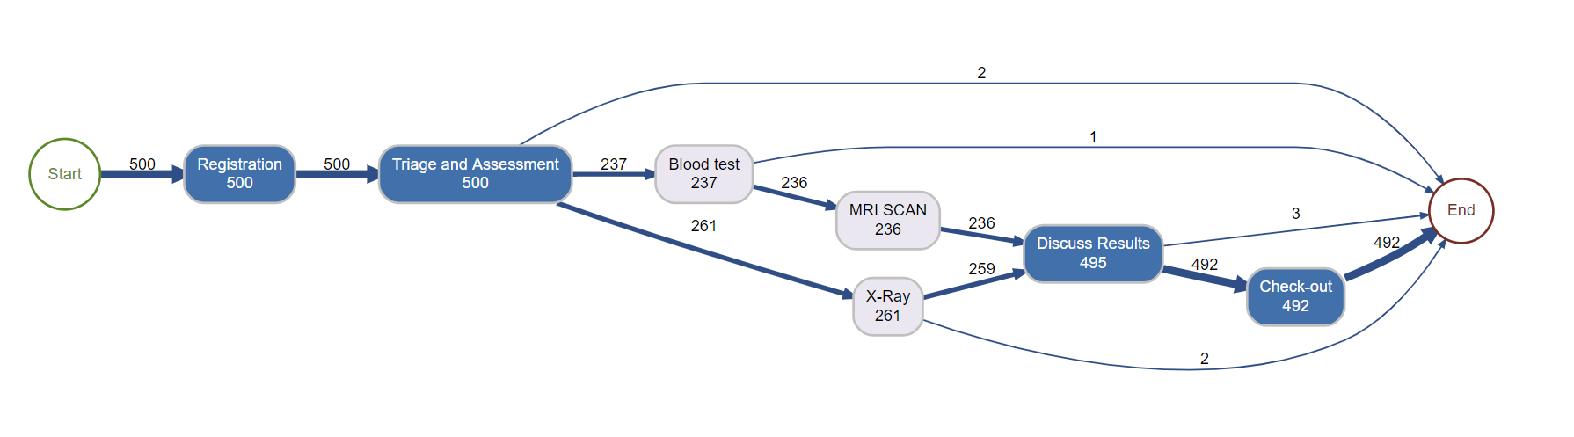
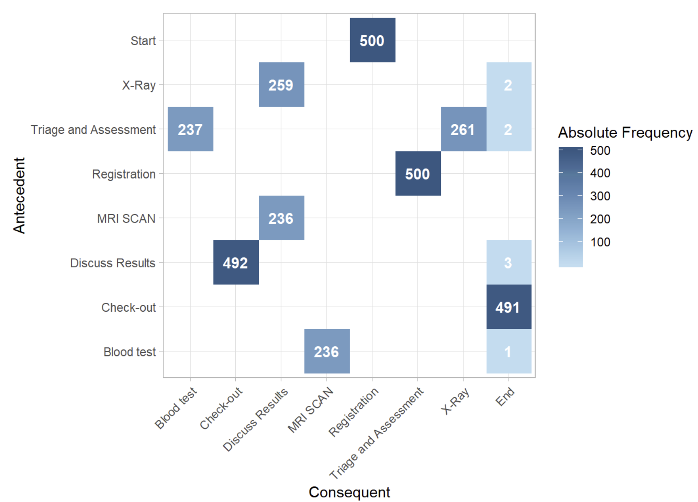
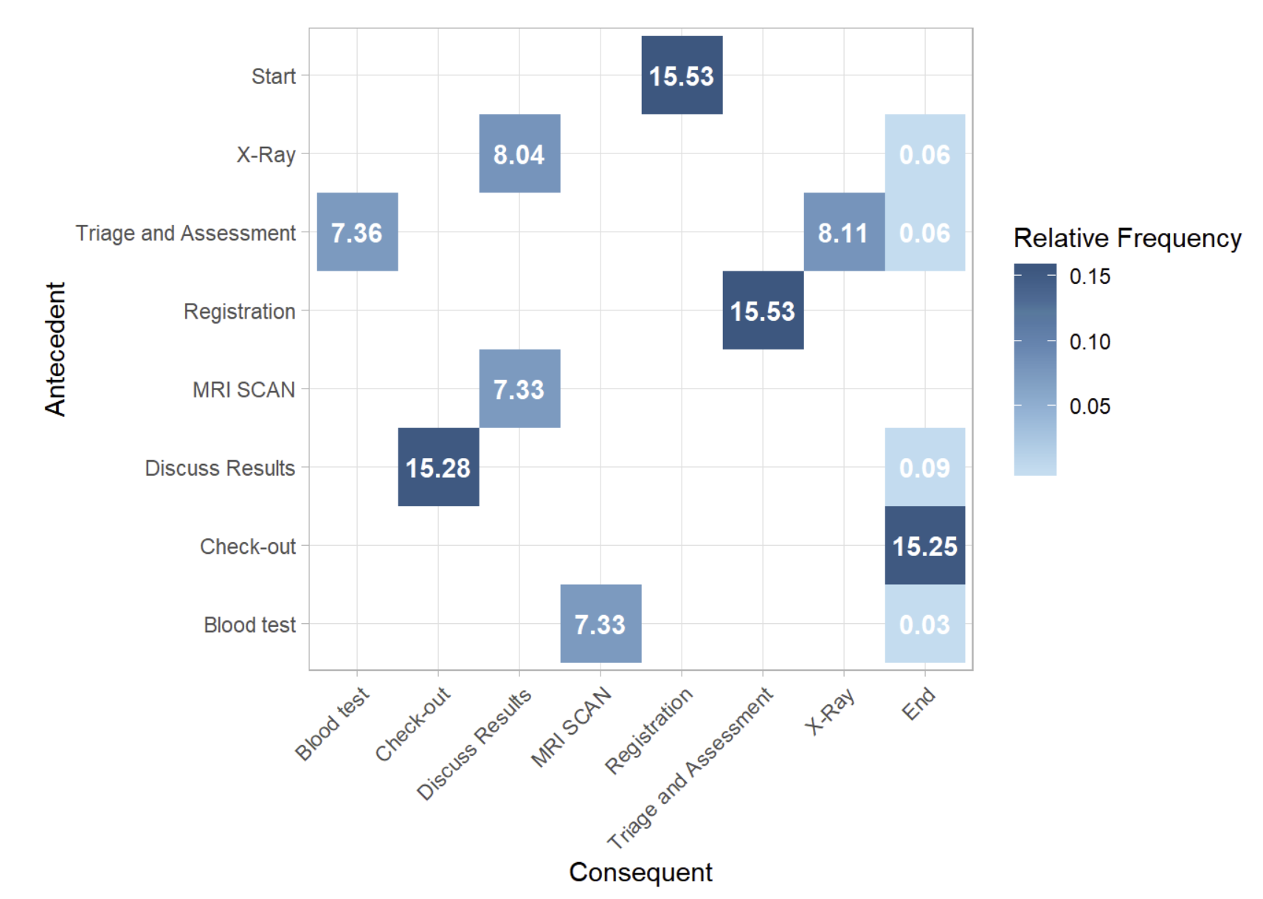
Process Map
Precedence Diagram
Notes:
Bupar is a really awesome suite of packages for business process analysis. https://www.bupar.net/index.html
A precedence diagrams is a two-dimensional matrix showing the flows between activities. This could be used to understand the frequencies between step reversals.
Here are two charts that show absolute frequency between process steps and relative frequency between process steps.

Slide 24
